Slide 1
Principles of Management
UEM

Slide 2
Management – Meaning & Definition
“Management is the art and Science of getting the maximum, possible output from the least of input, that is, resources, at minimum costs, and in a manner that satisfies all the stake holders of the organization, that is, shareholders, employees, suppliers etc… and also contributes to the development of the nation as a whole.”
Management can be defined as an effort for getting things done in order to achieve the pre-determined goals of the concern through coordination of human and other elements.
According to Henri Fayol – “To manage is to forecast and plan, to organize, to command, to coordinate and to control.”
According to F.W.Taylor – Management is the art of knowing what you want to do” and then seeing that it is done in the best and cheapest way.”
Management as a process “consisting of planning, organizing, directing, and controlling, performed to determine and accomplish the objectives by the use of people and resources”.

Slide 3
Nature of Management
Multidisciplinary – it freely draws ideas and concepts from other disciplines like psychology, sociology, economics, operations research etc. It integrates knowledge.
Dynamic nature of principles – they are flexible in nature and change with changes in the environment.
Relative, not Absolute Principles – management principles have different strength in different conditions.
Management: Science or Art – is both science and art.
Management as profession – as an emerging profession.
Universality of management – it is universal but not its principles which change as per situation.

Slide 4
Evolution of Management Thought
Early Contributions
Concept of organization and administration existed ” in Egypt in 1300 BC.
Confucius’s parables came long before Christ (551-479 B.C.)
Kautilya offered some principles of state administration in 320 BC.
Roman Catholic church gave the concept of staff personnel.
The Cameralists, a group of German and Austrian public administration-16th to 18th centuries.

Slide 5
Historical Background of Management
Ancient Management
Egypt (pyramids) and China (Great Wall)
Venetians (floating warship assembly lines)
Adam Smith
Published “The Wealth of Nations” in 1776
Advocated the division of labor (job specialization) to increase the productivity of workers
Industrial Revolution
Substituted machine power for human labor
Created large organizations in need of management

Slide 6
Management – An Art, Science or Profession
Science:
Any branch of knowledge to be considered a science (like – physics, chemistry, biology etc.) should fulfill the following conditions:
The existence of a systematic body of knowledge encompassing a wide array of principles;
The principle must explain a phenomenon by establishing cause – effect relationship;
Over the years, thanks to the contributions of many thinkers and practitioners, management, with its own principles has emerged as a systematic body of knowledge.

Slide 7
Management – An Art, Science or Profession
Management may be considered as inexact science because,
Management involves getting things done through people
The behavior of human beings cannot be accurately predicted
The output varies – consistency missing

Slide 8
Management – An Art, Science or Profession
An Art:
refers to the ‘know-how’ – the ways of doing things to accomplish a desired result.
As the saying goes ‘practice makes a man perfect; constant practice of the theoretical aspects (knowledge base) contributes for the formation and sharpening of the theory and practice. Therefore, what is required is the right blend of the theory and practice.
Effective practice of any art requires a thorough understanding of the science underlying it. The executives who attempt to manage without the conceptual understanding of management principles and techniques have to depend on luck or intuition.

Slide 9
Management – An Art, Science or Profession
As a Profession:
These are the days where we are hearing a lot about professional managers and their contribution to the economic development of the nation.
Therefore, it is appropriate to know the other dimension of management – whether it is a profession.
Since professionals are getting involved, it can be referred to as a profession.

Slide 10
Managerial Functions
Henri Fayol was the first to describe the four managerial functions when he was the CEO of a large mining company in the later 1800’s.
Fayol noted managers at all levels, operating in a for profit or not for profit organization, must perform each of the functions of:
Planning,
organizing,
leading,
controlling.

Slide 11
Four Functions of Management
Planning
Choose Goals
Controlling
Organizing
Monitor & measure
Working together
Leading
Coordinate

Slide 12
Planning
Planning is the process used by managers to identify and select appropriate goals and courses of action for an organization
3 steps to good planning :
1. Which goals should be pursued?
2. How should the goal be attained?
3. How should resources be allocated?
The planning function determines how effective and efficient the organization is and determines the strategy of the organization

Slide 13
Organizing
In organizing, managers create the structure of working relationships between organizational members that best allows them to work together and achieve goals.
Managers will group people into departments according to the tasks performed.
Managers will also lay out lines of authority and responsibility for members.
An organizational structure is the outcome of organizing. This structure coordinates and motivates employees so that they work together to achieve goals.

Slide 14
Leading
In leading, managers determine direction, state a clear vision for employees to follow, and help employees understand the role they play in attaining goals.
Leadership involves a manager using power, influence, vision, persuasion, and communication skills.
The outcome of the leading function is a high level of motivation and commitment from employees to the organization.

Slide 15
Controlling
In controlling, managers evaluate how well the organization is achieving its goals and takes corrective action to improve performance.
Managers will monitor individuals, departments, and the organization to determine if desired performance has been reached.
Managers will also take action to increase performance as required.
The outcome of the controlling function is the accurate measurement of performance and regulation of efficiency and effectiveness.

Slide 16
Why to Study Management Practices?
The more efficient and effective use of scarce resources that organizations make of those resources, the greater the relative well-being and prosperity of people in that society
Helps people deal with their bosses and coworkers
Opens a path to a well-paying job and a satisfying career

Slide 17
Different types of Managers
Supervisory or team managers are responsible for coordinating a subgroup of a particular function or a team composed of members from different parts of the organization.
A second set of managers includes functional, team, and general managers. Functional managers are responsible for the efficiency and effectiveness of an area, such as accounting or marketing.
Top managers are responsible for developing the organization’s strategy and being a steward for its vision and mission.

Slide 18
Management Levels
Organizations often have 3 levels of managers:
First-line Managers: responsible for day-to-day operation. They supervise the people performing the activities required to make the good or service.
Middle Managers: Supervise first-line managers. They are also responsible to find the best way to use departmental resources to achieve goals.
Top Managers: Responsible for the performance of all departments and have cross-departmental responsibility. They establish organizational goals and monitor middle managers.

Slide 19
Three Levels of Management
Top Managers
Middle Managers
First-line Managers
Non-management

Slide 20
Levels of Management
1. Top level management:
Example: Chairman, CEO, MD, GM
2. Middle level management:
Example: Functional managers, Branch Managers etc , Project Managers.
3. First-level management:
Example: Foreman, supervisor, inspector etc.

Slide 21
Levels of Management
We can categorize organizational members in two ways:
Operatives who work directly on a job or task and have no responsibility for overseeing the work of others.
Managers direct the activities of other people in the organization. Usually classified as top, middle, or first-line, managers supervise both operative and lower-level managers.
First-line managers supervise the day-to-day activities of operative employees.
Middle managers represent the level of management between first-line managers and top management. These managers translate the goals of top management into specific details that lower-level managers can perform.
Top managers make decisions about the direction of the organization and set policies that affect all organizational members.

Slide 22
Managerial Skills
Conceptual skills for the top management
Human skills for the middle management
Technical skill for the lower management

Slide 23
Skill Type Needed by Manager Level
Top
Managers
Middle
Managers
Line
Managers
Conceptual
Human
Technical

Slide 24
Technical Skills
“Business skills”
Using methods and techniques to perform a task
Keeping up with the latest technology in your job

Slide 25
Human Skills
“People skills”
Your relationships with all individuals and groups
Understanding
Communicating
Motivating
Resolving conflict
Working as a team member
“It’s not what you know, it’s who you know.”
Ethics

Slide 26
Conceptual Skills
Select alternatives to solve problems
Take advantage of opportunities
Be able to conceptualize, diagnose and analyze
Use math skills
Manage time

Slide 27
Managerial Roles
Described by Mintzberg.
A role is a set of specific tasks a person performs because of the position they hold.
Roles are directed inside as well as outside the organization.
There are 3 broad role categories:
1. Interpersonal
2. Informational
3. Decisional

Slide 28
Interpersonal Roles
Roles managers assume to coordinate and interact with employees and provide direction to the organization.
Figurehead role: symbolizes the organization and what it is trying to achieve.
Leader role: train, counsel, mentor and encourage high employee performance.
Liaison role: link and coordinate people inside and outside the organization to help achieve goals.

Slide 29
Informational Roles
Associated with the tasks needed to obtain and transmit information for management of the organization.
Monitor role: analyzes information from both the internal and external environment.
Disseminator role: manager transmits information to influence attitudes and behavior of employees.
Spokesperson role: use of information to positively influence the way people in and out of the organization respond to it.

Slide 30
Decisional Roles
Associated with the methods managers use to plan strategy and utilize resources to achieve goals.
Entrepreneur role: deciding upon new projects or programs to initiate and invest.
Disturbance handler role: assume responsibility for handling an unexpected event or crisis.
Resource allocator role: assign resources between functions and divisions, set budgets of lower managers.
Negotiator role: seeks to negotiate solutions between other managers, unions, customers, or shareholders.

Slide 31
Managerial Skills
There are three skill sets that managers need to perform effectively.
1. Conceptual skills: the ability to analyze and diagnose a situation and find the cause and effect.
2. Human skills: the ability to understand, alter, lead, and control people’s behavior.
3. Technical skills: the job-specific knowledge required to perform a task. Common examples include marketing, accounting, and manufacturing.
All three skills are enhanced through formal training, reading, and practice.

Slide 32
Functions of Management
Planning
Organising
Staffing
Directing
Controlling

Slide 33
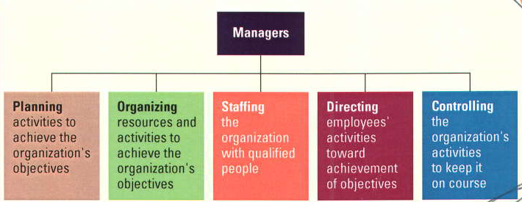
Management Functions
P - O - S - D - C

Slide 34
Management Functions
Planning
Process of determining the organization’s objectives and deciding how to accomplish them.

Slide 35
Management Functions - Organizing
Organizing –
Structuring of resources & activities to accomplish objectives efficiently & effectively.

Slide 36
Management Functions - Organizing
Importance:
Creates synergy
Establishes lines of authority
Improves communication
Improves competitiveness

Slide 37

Management Functions – Staffing
Staffing –
Hiring people (resources) to carry out the work of the organization.

Slide 38
Management Functions – Staffing
Importance
Recruiting
Determine skills
Motivate & train
Compensation levels

Slide 39



Management Functions – Staffing
Downsizing
Elimination of significant numbers of employees
(rightsizing, trimming the fat)

Slide 40
Management Functions – Directing
Directing
Motivating and leading employees to achieve organizational objectives.

Slide 41
Management Functions – Directing
Motivation
Incentives (raise, promotion)
Employee involvement (cost reduction, customer service, new products)
Recognition and appreciation

Slide 42

Management Functions – Controlling
Controlling
Process of evaluating and correcting activities to keep organization on course.

Slide 43
The Roles of
Management
The Mintzberg
Studies
Decisional
Informational
Interpersonal

Slide 44
Managerial Roles
Described by Mintzberg.
A role is a set of specific tasks a person performs because of the position they hold.
Roles are directed inside as well as outside the organization.
There are 3 broad role categories:
1. Interpersonal
2. Informational
3. Decisional

Slide 45
Interpersonal Roles
Roles managers assume to coordinate and interact with employees and provide direction to the organization.
Figurehead role: symbolizes the organization and what it is trying to achieve.
Leader role: train, counsel, mentor and encourage high employee performance.
Liaison role: link and coordinate people inside and outside the organization to help achieve goals.

Slide 46
Informational Roles
Associated with the tasks needed to obtain and transmit information for management of the organization.
Monitor role: analyzes information from both the internal and external environment.
Disseminator role: manager transmits information to influence attitudes and behavior of employees.
Spokesperson role: use of information to positively influence the way people in and out of the organization respond to it.

Slide 47
Decisional Roles
Associated with the methods managers use to plan strategy and utilize resources to achieve goals.
Entrepreneur role: deciding upon new projects or programs to initiate and invest.
Disturbance handler role: assume responsibility for handling an unexpected event or crisis.
Resource allocator role: assign resources between functions and divisions, set budgets of lower managers.
Negotiator role: seeks to negotiate solutions between other managers, unions, customers, or shareholders.

Slide 48
APPROACHES TO MANAGEMENT
Decision Theory Approach
Mathematical Approach
Systems Approach
McKinsey’s 7-S Approach

Slide 49
DECISION THEORY APPROACH
Manager – Decision maker
Organisation – Decision making unit.
Features
Management is decision making.
Members of Organisation - decision makers and problem solvers.
Decision making - control point in management
Increasing efficiency - the quality of decision
MIS, process & techniques of decision making are the subject matter of study.

Slide 50
DECISION THEORY APPROACH
Contributors
Simon, Forrester, etc.
Uses
Tools for making suitable decisions in organisations.
Limitation
Does not take the total view of management
Decision making - one aspect of management

Slide 51
MATHEMATICAL APPROACH
Management- logical entity
Actions- Mathematical symbols, Relationships and measurable data.
Features
Problem Solving mechanism with the help of mathematical tools and techniques.
Problems Expressed in mathematical symbols.
Variables in management – quantified.
Scope - Decision making, system analysis & some aspect of human behaviour.
Tools - Operations research ,simulation etc.

Slide 52
MATHEMATICAL APPROACH Cont..
Contributors
Newman, Charles Hitch, etc.
Uses
Provided Exactness in management discipline.
Limitations
Not a separate school
Technique in decision making.

Slide 53
SYSTEMS APPROACH
An enterprise - Man-Made system
Internal parts
Achieve established goals
External parts
Achieve interplay with its environment
Manager integrates his available facilities with goal achievement.
Uses
Quick Perception
Better Planning
Limitations
Complicated
Expensive

Slide 54
System
A set of interconnected elements to achieve a common objective
Elements are interrelated and interdependent
Composed of sub-systems, which in turn may be made up of other subsystems
The set of elements may be: Input(s), Process(es), or output(s)

Slide 55
Cybernetic systems – self-regulating, self-monitoring (feedback and control elements attached)
A system cannot exist in vacuum
It exists and functions in an environment, separated by its boundary
Several systems may share the same environment
Some systems may be connected by a shared boundary
Open system: interacts with its environment, exchanges inputs and outputs
Closed systems: do not interact, or exchange any inputs or outputs with its environment

Slide 56
System Approach Theory of Management
Features of System Approach:
1. System approach considers the organisation as a dynamic and inter-related set of parts. Each part represents a department or a sub-system. Each department has its sub-system. Continuous and effective interaction of sub-systems helps to attain goals of the larger system.

Slide 57
System Approach Theory of Management
2. It considers the impact of both near and distant future on organisational activities. Organisations constantly respond to changes in the internal and external environmental conditions.

Slide 58
System Approach Theory of Management
3. System approach integrates goals of different parts of the organisation (sub-systems or departments) with the organisation as a whole. It also integrates goals of the organisation with goals of the environment or society in which it operates. Integration of goals maintains equilibrium or balance and enables organisations to grow in the dynamic environment.

Slide 59
System Approach Theory of Management
4. It synthesizes knowledge of different fields of study such as biology, sociology, psychology, information systems, economics etc. As business organisation deals with different components of society, it makes best use of different fields of study to improve interaction with its counterparts.

Slide 60
System Approach Theory of Management
5. System approach enables organisations to frame policies that promote business objectives and social objectives. Business operates in the social system and social values, culture, beliefs and ethics are important constituents of business operations.

Slide 61
Limitations of Systems Theory
Critics of this theory claim this as a theoretical approach to management. The way an organisation actually works and solves problems (by applying different techniques and methods) has no appeal in the theory.
Relationship amongst parts of the organisation is emphasised upon but the exact nature of inter-dependence is not defined.
Exact relationship between internal and external environment of the organisation is also not defined.

Slide 62
Limitations of Systems Theory
System approach fails to provide uniform approach to management. Management principles change with changes in its environmental vairables. No standard set of principles apply to all types of organisations.
It fails to provide concepts that apply to all types of organisations. The small organisations are less adaptive to environmental variables than large organisations. The theory assumes that most of the organisations are big, complex and open systems. It, thus, fails to provide a unified theory.

Slide 63
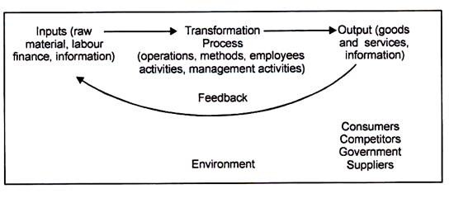
The Systems Model of Management

Slide 64
Components of Systems Theory of Management
The components are:
Sub-System
Synergy
Open and Closed Systems
System Boundary
Flow
Feedback.

Slide 65
Planning: Meaning
Planning is deciding in advance
what to do,
how to do it,
when to do it and
who should do it.
It involves anticipating the future and consciously choosing the future course of action.
“According to Haimann, Planning is the function that determines in advance what should be done.”
When a manager plans, he projects a course of action for further attempting to achieve a consistent co-ordinate structure of operations aimed at the desired results.

Slide 66
Nature of Planning
Planning is goal-oriented
Planning is a primary function
Planning is all-pervasive
Planning is a continuous process
Planning is forward-looking
Planning involves choice
Planning is directed towards efficiency

Slide 67
Importance of Planning
Focuses attention on objectives and result
Reduces uncertainty and risk
Provides sense of direction
Encourages innovation and creativity
Helps in co-ordination
Guides decision-making
Provide efficiency in operation

Slide 68
Planning Premises
These are the conditions under which planning activities will be undertaken
Planning premises are planning activities – the expected environmental and internal conditions
External premises include total factors in task environment like political, social, technological, competitor’s plan and actions, government policies, etc.
Internal premises include organization’s policies, resources of various types, and the ability of the organization to withstand the environmental pressure
Forecasting plays a major role in planning premises
At the top level, it is mostly externally focused and it becomes more internally focused at the lower management

Slide 69
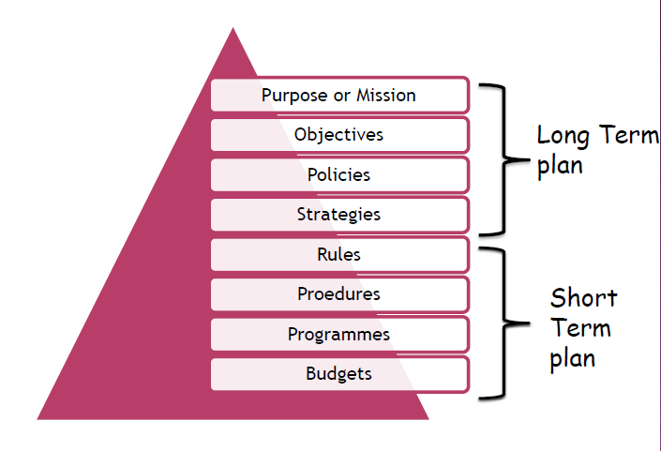
Hierarchy of Planning

Slide 70
Mission or Purpose
Mission identifies the basic tasks of an organization for which it exists.
It answers some of the basic questions :
What business we are in?
What will our business be?
Who are our customers?
What are our values and beliefs?
What will be due utility to the society?

Slide 71
Objectives
Objective are goals, aims or purposes that organization wish over varying periods of time.
No Planning is possible without setting up of Objectives.
Objectives are related to the future and are an essential part of the planning process
Goals and Objectives Should Be SMART
Specific
Measurable
Acceptable
Realistic
Timeframe

Slide 72
Policies
Policies are general statements or understandings which provide guidance in Decision Making to various managers.
Policies define boundaries within which decisions can be made and decision are directed towards the achievements of objectives.

Slide 73
Example of a company’s recruitment policy
Once a vacancy occurs a detailed job description is prepared before each post is advertised and is available to all applicants.
50% of the managerial vacancies will be filled by direct recruitment from management school graduates.
Rules pertaining to recruitment will specify the standard of eligibility, cut-off marks, offer terms, etc.

Slide 74
Strategies
It refers to a framework of grand plans formulated to meet the challenges of special circumstances.
Strategic plans define the action steps by which the organization intends to achieve its goals.
Strategic goals are broad goals of where the organization wants to be in the future. These goals pertain to the whole organization.
Strategic goals examples:
15% return on investment and 5% growth
No layoffs

Slide 75
Rules
A rule is an explicit statement that tells an employee what he or she can and cannot do.
Rules are “do” and “don't” statements put into place to promote the safety of employees and the uniform treatment and behavior of employees.
A Rule is definite and rigid and allows no deviation or discretion to the Subordinates.
Rules channel the behavior of workers in a desired direction

Slide 76
Program
A Program is a sequence of activities designed to implement policies and accomplish objectives.
Program may be taken as a combination of policies, procedures, rules, budgets, task assignment , etc developed for specific purpose of carrying out a particulars course of action.

Slide 77
Budget
It is a prior plan about how many resources (manpower, time, m/c hrs & money) needs to be allocated to a given job of the organization.
A pre-determined statement of management policy during period which provides a standard for comparison with the results actually achieved.
There should be an active involvement of top management while preparing a budget.

Slide 78
Types of Plans
On the basis of Approach adopted
– Proactive, Reactive
On the basis of Importance
– Strategic, Tactical, Operational
On the basis of Time
– Long term, Intermediate, Short term
On the basis of Use
– Single, Standing

Slide 79
Proactive Plan
It involves designing suitable course of action in anticipation of likely changes in relevant environment.
Needs of planning are forecasted.
It is operational an depends on the will of the management.
Involves broad planning wide environmental scanning, decentralized control.

Slide 80
Reactive Plan
It is a plan made as a response to the environmental needs or changes.
It is enforced due to change in technology / environment.
It is not optional and has to be implemented when required.
Becomes invalid when not done at suitable time.

Slide 81
Strategic plan
Strategic plans define the framework of the organization’s vision and how the organization intends to make its vision a reality.
Strategic plan is the plan which is formulated by the top level management for a long period of time of five years or more.
They decide the major goals and policies to achieve the goals.
It takes in a note of all the external factors and risks involved and makes a long-term policy of the organization.
It involves the determination of strengths and weaknesses, external risks, mission, and control system to implement plans.

Slide 82
Tactical Plan
Tactical plans describe the tactics that the managers plan to adopt to achieve the objectives set in the strategic plan.
Tactical plan is the plan which is concerned with the integration of various organizational units and ensures implementation of strategic plans on day to day basis.
It involves how the resources of an organization should be used in order to achieve the strategic goals.
The tactical plan is also known as coordinative or functional plan.

Slide 83
Operational Plan
Operational plans are the plans which are formulated by the lower level management for short term period of up to one year to create specific action steps that support the strategic and tactical plans.
It is concerned with the day to day operations of the organization.
It is detailed and specific and usually based on past experiences.
It usually covers functional aspects such as production, finance, Human Resources etc.
Operational plans can be:
Standing plans − Drawn to cover issues that managers face repeatedly, e.g. policies, procedures, rules.
Ongoing plans − Prepared for single or exceptional situations or problems and are normally discarded or replaced after one use, e.g. programs, projects, and budgets.

Slide 84
Long-term plan
Involves plans typically for 3-5 years.
Long-term plan is the long-term process that business owners use to reach their business mission and vision.
It determines the path for business owners to reach their goals.
It also reinforces and makes corrections to the goals as the plan progresses.

Slide 85
Short-term plan
Short-term plan involves plans for a few weeks or at most a year.
It allocates resources for the day-to-day business development and management within the strategic plan.
Short-term plans outline objectives necessary to meet intermediate plans and the strategic planning process.

Slide 86
Single Plan
These plans are connected with some special problems.
These plans end the moment of the problems to be solved.
They are not used, once after their use.
They are further re-created whenever required.

Slide 87
Standing Plan
These plans are formulated once and they are repeatedly used.
These plans continuously guide the managers. That is why it is said that a standing plan is a standing guide to solving the problems.
These plans include mission, policies, objective, rules and strategy.

Slide 88
Planning Limitations/Barriers
Lack of accurate information
Time and cost
Resistance to change
Lack of ability to plans
False sense of security
Environmental constraints

Slide 89
Steps in planning
15
Being aware of opportunity
Setting objectives or goals
Considering planning premises Identifying alternatives Comparing alternatives with goals Choosing an alternative Formulating support plans
Quantifying plans by making budgets

Slide 90
1. Being aware of opportunities
◆ Analysis of external environment – real starting point for planning
◆ Setting realistic objectives depends on the awareness of external environment or opportunities.
◆ Planning requires a realistic diagnosis of opportunity situation

Slide 91
2. Establishing objectives
◆ Objectives – specify the expected results and indicate the end points of what is to be done.
◆ Enterprise/ Company’s objective give direction to major plans

Slide 92
3. Developing premises
◆ Premises – assumptions about the environment in which plan is to be carried out.
Principle of planning premises – the more thoroughly individuals charged with planning
understand and agree to utilize the consistent planning premises, the more coordinated enterprise planning will be.

Slide 93
4. Determining alternative courses
◆ It is to search for and examine alternative course of action
◆ Number of alternative that can be thoroughly examined
◆ The planner must usually make a preliminary analysis to find out best alternative.

Slide 94
5. Evaluating alternative courses
◆ After examining the strong and weak points of
alternatives
◆ Evaluate the alternatives by weighing them as
compared with goals or objectives of a firm.
◆ One course may appear to be most profitable – but high risk and not match firm’s or company’s goal

Slide 95
6. Selecting a course of action
◆ Real point of decision making
◆ Alternative course of action – one or more advisable
◆ Manager decide to follow several courses
rather than one but course

Slide 96
7. Formulating derivative plans
Derivative plans/supporting plans – invariably required to support the basic plan

Slide 97
8. Quantifying – Budgeting plans
◆ To quantify them by converting them into budgets
◆ The overall budget of a firm/an enterprise represents the sum total of income and expenses
◆ Budgets become a means of adding the various
plan and set important standards against which planning process can be measured

Slide 98
Objectives
◆ Objectives were defined as important ends towards which organizational and individual activities are directed
◆ The emphasis is on verifiable objectives
– means at the end of the period – whether or not objective has been achieved

Slide 99
Nature of objectives
25
Objectives state end result and overall objectives need to be supported by sub-objectives
Objectives forms a hierarchy as well as network

Slide 100
Hierarchy of objectives
◆ Objectives form a hierarchy, ranging from the broad aim to specific individual objectives
◆ Zenith of hierarchy – mission/purpose
◆ General objectives and strategies, such as designing, producing and marketing reliable, low cost, fuel efficient automobiles
◆ KRA – Key result area – These are the areas in which performance is essential for the success of the enterprise.

Slide 101
Illustration of Hierarchy of Objectives
1.
Purpose
Board of
directors
2. Mission
3. Strategic objectives
Top Management
4. Overall Objectives
5. Divisional objectives
Middle Management
6. Department and unit Objectives
Operational level managers
Individual objectives

Slide 102
Setting Objectives and Organizational hierarchy
28
Managers at different levels in the organizational hierarchy
are concerned with different kinds of objectives
Board of Directors and top level managers – involved in determining the purpose, the mission and overall objectives of firm.
Middle level managers – Vice president or marketing/production division objectives and department objectives
Low level managers – setting the objectives of departments and units as well as their sub-ordinates

Slide 103
Setting of objectives –approaches
Top down approach
Bottom up approach

Slide 104
Multiplicity of approaches
◆ Objectives – normally multiple
◆ The objectives should be verifiable and all the objectives are realistic, attainable and precise.

Slide 105
How to set objectives
Examples of non verifiable objectives:
To make a reasonable profit
To improve communication
To improve productivity of the production department
Contd…

Slide 106
Examples of Verifiable objectives:
To achieve a return on investment of 12% at the end of the current fiscal year
To issue a two page monthly newsletter beginning July 1 2005, involving not more than 40 working hours of preparation time.
To increase production output by 5% by December 31, 2005 without additional costs while maintaining the current quality level
The management, people or a group of individual can’t work without clear aim.

Slide 107
Quantitative and Qualitative objectives
◆ Quantitative objectives – are verifiable objectives can be measured in terms of numerical values (e.g.) financial reports; profits and loss, cash flow
◆ Qualitative objectives – are difficult to verify objectives - can be measured in terms of attributes or characteristics (e.g.) quality of products

Slide 108
Guidelines for setting objectives
◆ There are certain guidelines for setting the objectives of an enterprise or firm. It is indeed a difficult task
◆ It requires intelligent coaching by the superior and
extensive practice by the sub-ordinate
List of objectives should not be too long, yet cover main features
Objectives should be verifiable and state what is to be accomplished
Contd…

Slide 109
3. Objectives should present a challenge, indicate priorities
Objectives should be consistent throughout the organization
Objectives should be precise and identifiable
Objectives should cover on the area of resources and authority
The above mentioned are some of the important guidelines for establishing objectives

Slide 110
The Strategic Planning Process
•
In today's highly competitive business environment, budget-oriented planning or forecast-based planning methods are insufficient for a large corporation to survive and prosper. The firm must engage in strategic planning that clearly defines objectives and assesses both the internal and external situation to formulate strategy, implement the strategy, evaluate the progress, and make adjustments as necessary to stay on track.
A simplified view of the strategic planning process is shown by the following diagram:
•
Mission and objectives
Environmental Scanning
Strategy Formulation
Strategy Implementation
Evaluation and Control

Slide 111
Mission and Objectives
The mission statement describes the company's business vision, including the unchanging values and purpose of the firm and forward-looking visionary goals that guide the pursuit of future opportunities.
Guided by the business vision, the firm's leaders can define measurable financial and strategic objectives. Financial objectives involve measures such as sales targets and earnings growth. Strategic objectives are related to the firm's business position, and may include measures such as market share and reputation.

Slide 112
Environmental Scan
The environmental scan includes the following components:
Internal analysis of the firm
Analysis of the firm's industry (task environment)
External macro environment (PEST analysis)
The internal analysis can identify the firm's strengths and weaknesses and the external analysis reveals opportunities and threats. A profile of the strengths, weaknesses, opportunities, and threats is generated by means of a SWOT analysis
An industry analysis can be performed using a framework developed by Michael Porter known as Porter's five forces. This framework evaluates entry barriers, suppliers, customers, substitute products, and industry rivalry.

Slide 113
Strategy Formulation
Given the information from the environmental scan, the firm should match its strengths to the opportunities that it has identified, while addressing its weaknesses and external threats.
To attain superior profitability, the firm seeks to develop a competitive advantage over its rivals. A competitive advantage can be based on cost or differentiation. Michael Porter identified three industry-independent generic strategies from which the firm can choose.

Slide 114
Strategy Implementation
The selected strategy is implemented by means of programs, budgets, and procedures. Implementation involves organization of the firm's resources and motivation of the staff to achieve objectives.
The way in which the strategy is implemented can have a significant impact on whether it will be successful. In a large company, those who implement the strategy likely will be different people from those who formulated it. For this reason, care must be taken to communicate the strategy and the reasoning behind it. Otherwise, the implementation might not succeed if the strategy is misunderstood or if lower-level managers resist its implementation because they do not understand why the particular strategy was selected.

Slide 115
Evaluation & Control
The implementation of the strategy must be monitored and adjustments made as needed.
Evaluation and control consists of the following steps:
Define parameters to be measured
Define target values for those parameters
Perform measurements
Compare measured results to the pre-defined standard
Make necessary changes

Slide 116
Hierarchical Levels of Strategy
Strategy can be formulated on three different levels:
corporate level
business unit level
functional or departmental level.
While strategy may be about competing and surviving as a firm, one can argue that products, not corporations compete, and products are developed by business units. The role of the corporation then is to manage its business units and products so that each is competitive and so that each contributes to corporate purposes.

Slide 117
Corporate Level Strategy
Corporate level strategy fundamentally is concerned with the selection of businesses in which the company should compete and with the development and coordination of that portfolio of businesses.
Corporate level strategy is concerned with:
Reach - defining the issues that are corporate responsibilities; these might include identifying the overall goals of the corporation, the types of businesses in which the corporation should be involved, and the way in which businesses will be integrated and managed.
Competitive Contact - defining where in the corporation competition is to be localized. Take the case of insurance: In the mid-1990's, Aetna as a corporation was clearly identified with its commercial and property casualty insurance products. The conglomerate Textron was not. For Textron, competition in the insurance markets took place specifically at the business unit level, through its subsidiary, Paul Revere. (Textron divested itself of The Paul Revere Corporation in 1997.)
Managing Activities and Business Interrelationships - Corporate strategy seeks to develop synergies by sharing and coordinating staff and other resources across business units, investing financial resources across business units, and using business units to complement other corporate business activities. Igor Ansoff introduced the concept of synergy to corporate strategy.
Management Practices - Corporations decide how business units are to be governed: through direct corporate intervention (centralization) or through more or less autonomous government (decentralization) that relies on persuasion and rewards.
Corporations are responsible for creating value through their businesses. They do so by managing their portfolio of businesses, ensuring that the businesses are successful over the long-term, developing business units, and sometimes ensuring that each business is compatible with others in the portfolio

Slide 118
Business Unit Level Strategy
A strategic business unit may be a division, product line, or other profit center that can be planned independently from the other business units of the firm.
At the business unit level, the strategic issues are less about the coordination of operating units and more about developing and sustaining a competitive advantage for the goods and services that are produced. At the business level, the strategy formulation phase deals with:
positioning the business against rivals
anticipating changes in demand and technologies and adjusting the strategy to accommodate them
Influencing the nature of competition through strategic actions such as vertical integration and through political actions such as lobbying.
Michael Porter identified three generic strategies (cost leadership, differentiation, and focus) that can be implemented at the business unit level to create a competitive advantage and defend against the adverse effects of the five forces.

Slide 119
Functional Level Strategy
The functional level of the organization is the level of the operating divisions and departments. The strategic issues at the functional level are related to business processes and the value chain. Functional level strategies in marketing, finance, operations, human resources, and R&D involve the development and coordination of resources through which business unit level strategies can be executed efficiently and effectively.
Functional units of an organization are involved in higher level strategies by providing input into the business unit level and corporate level strategy, such as providing information on resources and capabilities on which the higher level strategies can be based. Once the higher- level strategy is developed, the functional units translate it into discrete action-plans that each department or division must accomplish for the strategy to succeed.

Slide 120
PEST Analysis
A scan of the external macro-environment in which the firm operates can be expressed in terms of the following factors:
Political Economic Social Technological
The acronym PEST (or sometimes rearranged as "STEP") is used to describe a framework for the analysis of these macro environmental factors

Slide 121
Political Factors
Political factors include government regulations and legal issues and define both formal and informal rules under which the firm must operate. Some examples include:
tax policy
employment laws
environmental regulations
trade restrictions and tariffs
political stability

Slide 122
Economic Factors
Economic factors affect the purchasing power of potential customers and the firm's cost of capital. The following are examples of factors in the macro economy:
economic growth
interest rates
exchange rates
inflation rate

Slide 123
Social Factors
Social factors include the demographic and cultural aspects of the external macro environment. These factors affect customer needs and the size of potential markets. Some social factors include:
health consciousness
population growth rate
age distribution
career attitudes
emphasis on safety

Slide 124
Technological Factors
Technological factors can lower barriers to entry, reduce minimum efficient production levels, and influence outsourcing decisions. Some technological factors include:
R&D activity
automation
technology incentives
rate of technological change

Slide 125
SWOT Analysis
A scan of the internal and external environment is an important part of the strategic planning process.
Environmental factors internal to the firm usually can be
classified as strengths (S) or weaknesses (W), and those external to the firm can be classified as opportunities (O) or threats (T). Such an analysis of the strategic environment is referred to as a SWOT analysis.
The SWOT analysis provides information that is helpful in matching the firm's resources and capabilities to the competitive environment in which it operates. As such, it is instrumental in strategy formulation and selection

Slide 126
Strengths
A firm's strengths are its resources and capabilities that can be used as a basis for developing a competitive advantage. Examples of such strengths include:
patents
strong brand names
good reputation among customers
cost advantages from proprietary know-how
exclusive access to high grade natural resources
favorable access to distribution networks

Slide 127
Weaknesses
The absence of certain strengths may be viewed as a weakness. For example, each of the following may be considered weaknesses:
lack of patent protection a weak brand name
poor reputation among customers high cost structure
lack of access to the best natural resources
lack of access to key distribution channels
In some cases, a weakness may be the flip side of strength. Take the case in which a firm has a large amount of manufacturing capacity. While this capacity may be considered a strength that competitors do not share, it also may be a considered a weakness if the large investment in manufacturing capacity prevents the firm from reacting quickly to changes in the strategic environment.

Slide 128
Opportunities
The external environmental analysis may reveal certain new opportunities for profit and growth. Some examples of such opportunities include:
an unfulfilled customer need
arrival of new technologies
loosening of regulations
removal of international trade barriers

Slide 129
Threats
Changes in the external environmental also may present threats to the firm. Some examples of such threats include:
shifts in consumer tastes away from the firm's products
emergence of substitute products
new regulations
increased trade barriers

Slide 130
The SWOT Matrix
A firm should not necessarily pursue the more lucrative opportunities. Rather, it may have a better chance at developing a competitive advantage by identifying a fit between the firm's strengths and upcoming opportunities. In some cases, the firm can overcome a weakness in order to prepare itself to pursue a compelling opportunity.
To develop strategies that take into account the SWOT profile, a matrix of these factors can be constructed.

Slide 131
SWOT Matrix
The SWOT matrix (also known as a TOWS Matrix) is shown below:
 | Strengths | Weaknesses
Opportunities | S-O strategies | W-O strategies
Threats | S-T strategies | W-T strategies

Slide 132
Competitive Advantage
When a firm sustains profits that exceed the average for its industry, the firm is said to possess a competitive advantage over its rivals. The goal of much of business strategy is to achieve a sustainable competitive advantage.
Michael Porter identified two basic types of competitive advantage:
cost advantage differentiation advantage
A competitive advantage exists when the firm is able to deliver the same benefits as competitors but at a lower cost (cost advantage), or deliver benefits that exceed those of competing products (differentiation advantage). Thus, a competitive advantage enables the firm to create superior value for its customers and superior profits for itself.
Cost and differentiation advantages are known as positional advantages since they describe the firm's position in the industry as a leader in either cost or differentiation.

Slide 133
Value Creation
The firm creates value by performing a series of activities that Porter identified as the value chain. In addition to the firm's own value-creating activities, the firm operates in a value system of vertical activities including those of upstream suppliers and downstream channel members.
To achieve a competitive advantage, the firm must perform one or more value creating activities in a way that creates more overall value than do competitors.
Superior value is created through lower costs or superior benefits to the consumer (differentiation).

Slide 134
Business Portfolio Matrix
Product Portfolio Management Tools
BCG Matrix
GE Matrix

Slide 135


The BCG Matrix
Growth share matrix is a portfolio planning method that evaluates a company’s products in terms of their market growth rate and relative share.
Products are classified as: Stars, Cash Cows, Question marks and Dogs
Marketing efforts, or investments, will change, depending on the product’s classification

Slide 136
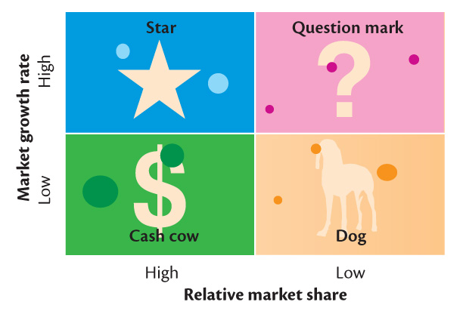
The BCG Matrix

Slide 137
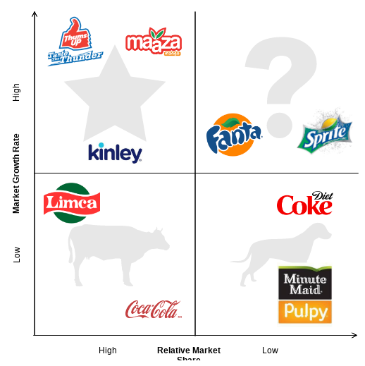
BCG example

Slide 138
The BCG Matrix
Stars are high-growth, high-share businesses or products requiring heavy investment to finance rapid growth. They will eventually turn into cash cows.
Cash cows are low-growth, high-share businesses or products that are established; require less investment to maintain market share in a stable market.
Question marks are low-share business units in high-growth markets requiring a lot of cash to hold their share.
Dogs are low-growth, low-share businesses and products that may generate enough cash to maintain themselves but do not promise to be large sources of cash. Not worth much investment.

Slide 139
The BCG Matrix
Problems with Matrix Approaches
Difficulty in defining SBUs and measuring market share and growth
Time consuming
Expensive
Focus on current businesses, not future planning

Slide 140
GE Matrix
A more advanced model developed by General Electric: measuring market attractiveness and business strength
Market attractiveness is a composite measure of the potential for sales and profits in a particular market segment
Business strength is the strength of our offering relative to other companies’ products
GE Matrix is an expansion of the BCG matrix. The dimensions are more comprehensive and detailed.

Slide 141
GE Matrix
GE Matrix
Market Attractiveness
Growth
Diversity
Competitive
Structure Change
Technology Change
Social Environment
Business Strength
Size of Market & Share
Company Growth Rate
Profit
Margins
Technology Platform
Image
People

Slide 142
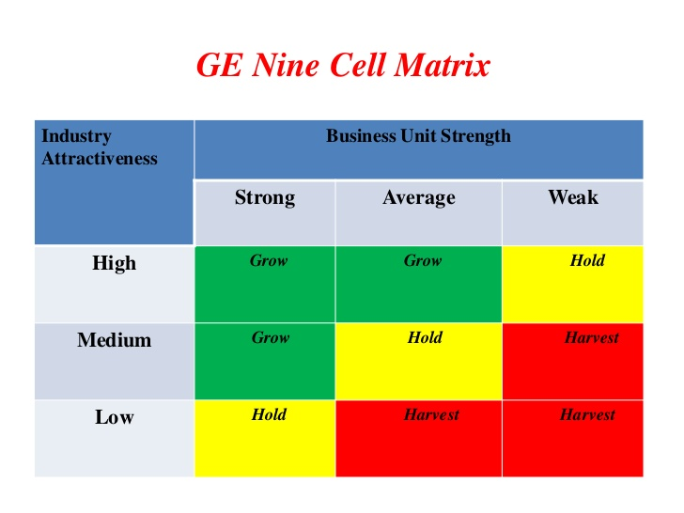
GE MATRIX

Slide 143
Decision Making
Decisions
Choices from two or more alternatives
All organizational members make decisions
Decision-Making Process
Step 1 - Identifying a Problem
problem - discrepancy between an existing and a desired state of affairs

Slide 144
Decision Making
Decision-Making Process (continued)
Step 2 - Identifying Decision Criteria
decision criteria - what’s relevant in making a decision
Step 3 - Allocating Weights to the Criteria
must weight the criteria to give them appropriate priority in the decision
Step 4 - Developing Alternatives
list the viable alternatives that could resolve the problem without evaluating them

Slide 145
Decision Making
Decision-Making Process (continued)
Step 5 - Analyzing Alternatives
each alternative is evaluated against the criteria
Step 6 - Selecting an Alternative
choosing the best alternative from among those considered
Step 7 - Implementing the Decision
implementation - conveying the decision to those affected by it and getting their commitment to it
Step 8 - Evaluating Decision Effectiveness
determine whether the problem is resolved

Slide 146
Decision Making
Rational Decision Making
Decisions are consistent, value-maximizing choices within specified constraints
Managers assumed to make rational decisions
Assumptions of Rationality - decision maker would:
be objective and logical
carefully define a problem
have a clear and specific goal
select the alternative that maximizes the likelihood of achieving the goal
make decision in the firm’s best economic interests
Managerial decision making seldom meets all the tests

Slide 147
Decision Making
Bounded Rationality
Behave rationally within the parameters of a simplified decision-making process that is limited by an individual’s ability to process information
Accept solutions that are “good enough”
Escalation of commitment - increased commitment to a previous decision despite evidence that it may have been wrong

Slide 148
Decision Making
Role of Intuition
Intuitive decision making - subconscious process of making decisions on the basis of experience and accumulated judgment
does not rely on a systematic or thorough analysis of the problem
generally complements a rational analysis

Slide 149
Decision Making
Significance of Decision-Making:
Managers who use a rational, intelligent, and systematic approach are more likely to come up with high quality solutions to the problems they face than the ones who do not use this approach.
Rational decision-makers have a clear understanding of alternative courses of action to accomplish a goal under a particular set of circumstances.
Rational decision-making is based on the information available with the decision-makers and their ability to evaluate alternatives.
Rational decision-making aims at deciding the best solution by selecting the alternative that most effectively facilitates goal achievement

Slide 150
Decision Making
Limitations of Decision-Making:
It is very difficult for managers to be completely rational in their decision-making since decisions are taken keeping the future in mind, and the future is very uncertain.
It is very difficult to determine all the alternative courses of action that might be followed to accomplish a goal.
Rational decision-making becomes almost an impossible task when one has to explore areas which have never been ventured into before.

Slide 151
Decision Making
Limitations of Decision-Making:
iv. In most cases, all possible alternatives generated cannot be thoroughly analyzed, even with sophisticated analytical techniques and computers.
v. Even though the decision-maker strives to be completely rational, sometimes limitations of information, time and certainty, curb rationality.
vi. Sometimes, managers allow their risk-avoiding tendency to disrupt their rational decision­-making process.

Slide 152
Decision Making
Identify Limiting Factors
In order to choose the best alternative and make a decision every manager needs to have the ideal resources − information, time, personnel, equipment, and supplies. But this is an ideal situation and may not always be possible.
A limiting factor is something that stands in the way of accomplishing a desired objective.

Slide 153
Decision Making
Developing Potential Alternatives
Recognizing the limiting factor in a given situation makes it possible to narrow down the search for alternatives and make the best decision possible with the information, resources, and time available.
Some methods for developing alternatives are −
Brainstorming, where a group works together to generate ideas and alternative solutions.
Nominal group technique is a method that involves the use of a highly structured meeting, complete with an agenda, and restricts discussion or interpersonal communication during the decision-making process.
Delphi technique where the participants do not meet, but a group leader uses written questionnaires to conduct the decision making.

Slide 154
Decision Making
Analysis of the Alternatives
This is an important stage in the decision-making process and perhaps the toughest. Managers must identify the merits and demerits of each alternative and weigh them in light of various situations before making a final decision.
Evaluating the alternatives can be done in numerous ways. Here are a few possibilities −
Qualitative and quantitative measurements
Perform a cost‐effectiveness analysis for each alternative
Marginal analysis

Slide 155
Decision Making
Selecting Alternatives
Once the alternatives are analyzed and evaluated, the manager has to choose the best one. The manager needs to choose the alternative that gives the most advantage while meeting all the required criteria. Sometimes the choice is simple with obvious benefits, at times the optimal solution is a combination of several alternatives. At times when the best alternative may not be obvious, the manager uses probability estimates, research and analysis aided by his experience and judgment.

